Slide 1
Chapter 7: Securing Site-to-Site Connectivity
Connecting Networks
Notes:
Cisco Networking Academy program
Connecting Networks
Chapter 7: Securing Site-to-Site Connectivity

Slide 2
Chapter 7: Securing Site-to-Site Connectivity
7.1 VPNs
7.2 Site-to-Site GRE Tunnels
7.3 Summary
Notes:
Chapter 7

Slide 3
Chapter 7: Objectives
After completing this chapter, students will be able to:
Describe benefits of VPN technology.
Describe site-to-site and remote access VPNs.
Describe the purpose and benefits of GRE tunnels.
Configure a site-to-site GRE tunnel.
Notes:
Chapter 7 Objectives

Slide 4
Chapter 7: Introduction
Security is a concern when using the public Internet to conduct business.
Virtual Private Networks (VPNs) are used to ensure the security of data across the Internet.
A VPN is used to create a private tunnel over a public network.
Data can be secured by using encryption in this tunnel through the Internet and by using authentication to protect data from unauthorized access.
This chapter explains the concepts and processes related to VPNs, as well as the benefits of VPN implementations, and the underlying protocols required to configure VPNs.

Slide 5
7.1 VPNs
Notes:
7.1 VPNs

Slide 6
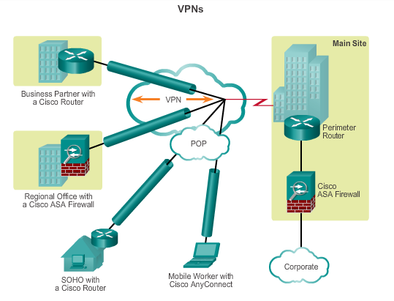
Fundamentals of VPNs Introducing VPNs
VPNs are used to create an end-to-end private network connection over third-party networks, such as the Internet or extranets.
To implement VPNs, a VPN gateway is necessary: Could be a router, a firewall, or a Cisco Adaptive Security Appliance (ASA).
Notes:
7.1.1.1 Introducing VPNs

Slide 7
Fundamentals of VPNs Benefits of VPNs
Cost savings
Enable organizations to use cost-effective, third-party Internet transport to connect remote offices and remote users to the main site.
Scalability
Enable organizations to use the Internet infrastructure within ISPs and devices, which makes it easy to add new users.
Notes:
7.1.1.2 Benefits of VPNs

Slide 8
Fundamentals of VPNs Benefits of VPNs (cont.)
Compatibility with broadband technology
Allow mobile workers and telecommuters to take advantage of high-speed, broadband connectivity, such as DSL and cable, to gain access to the networks of their organization, providing workers flexibility and efficiency.
Provide a cost-effective solution for connecting remote offices.
Security
Can include security mechanisms that provide the highest level of security by using advanced encryption and authentication protocols that protect data from unauthorized access.
Notes:
7.1.1.2 Benefits of VPNs

Slide 9
Types of VPNs Site-to-Site VPNs
Connect entire networks to each other, in the past, a leased line or Frame Relay connection was required to connect sites, but because most corporations now have Internet access, these connections can be replaced with site-to-site VPNs.
Internal hosts have no knowledge that a VPN exists.
Created when devices on both sides of the VPN connection are aware of the VPN configuration in advance.
Notes:
7.1.2.1 Site-to-Site VPNs

Slide 10
Types of VPNs Site-to-Site VPNs (cont.)
End hosts send and receive normal TCP/IP traffic through a VPN gateway.
The VPN gateway is responsible for encapsulating and encrypting outbound traffic for all traffic from a particular site
The VPN gateway then sends it through a VPN tunnel over the Internet to a peer VPN gateway at the target site.
Upon receipt, the peer VPN gateway strips the headers, decrypts the content, and relays the packet toward the target host inside its private network.
Notes:
7.1.2.1 Site-to-Site VPNs

Slide 11
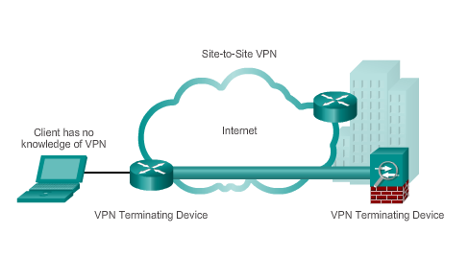
Types of VPNs Site-to-Site VPNs (cont.)
Notes:
7.1.2.1 Site-to-Site VPNs

Slide 12
Types of VPNs Remote Access VPNs
Support the needs of telecommuters, mobile users, and extranet, consumer-to-business traffic.
Support a client/server architecture, where the VPN client (remote host) gains secure access to the enterprise network via a VPN server device at the network edge.
Used to connect individual hosts that must access their company network securely over the Internet.
VPN client software may need to be installed on the mobile user’s end device (Cisco AnyConnect Secure Mobility Client).
When the host tries to send any traffic, the VPN Client software encapsulates and encrypts this traffic and sends over the Internet to the VPN gateway at the edge of the target network.
Notes:
7.1.2.2 Remote Access VPNs

Slide 13
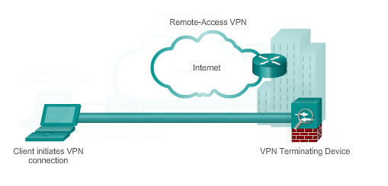
Types of VPNs Remote Access VPNs (cont.)
Notes:
7.1.2.2 Remote Access VPNs

Slide 14
7.2 Site-to-Site GRE Tunnels
Notes:
7.2 Site-to-Site GRE Tunnels

Slide 15
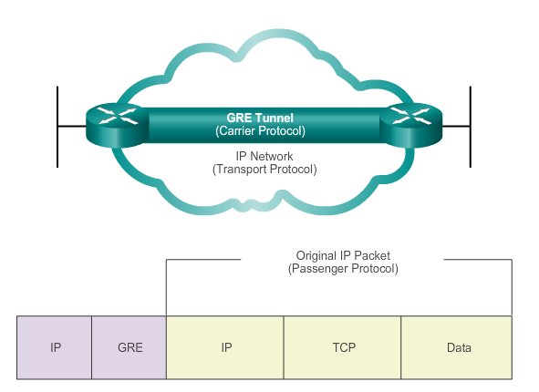
Fundamentals of Generic Routing Encapsulation Introduction to GRE
Basic, non-secure, site-to-site VPN tunneling protocol developed by Cisco
Encapsulates a wide variety of protocol packet types inside IP tunnels
Creates a virtual point-to-point link to routers at remote points, over an IP internetwork
Notes:
7.2.1.1 Introduction to GRE

Slide 16
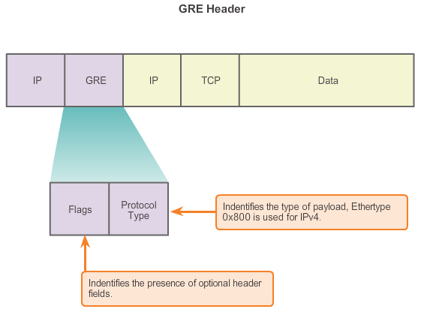
Fundamentals of Generic Routing Encapsulation Characteristics of GRE
Notes:
7.2.1.2 Characteristics of GRE

Slide 17
Fundamentals of Generic Routing Encapsulation Characteristics of GRE
GRE has these characteristics:
GRE is defined as an IETF standard.
IP protocol 47 is used to identify GRE packets.
GRE encapsulation uses a protocol type field in the GRE header to support the encapsulation of any OSI Layer 3 protocol.
GRE itself is stateless; it does not include any flow-control mechanisms, by default.
GRE does not include any strong security mechanisms to protect its payload.
The GRE header, together with the tunneling IP header, creates at least 24 bytes of additional overhead for tunneled packets.
Notes:
7.2.1.2 Characteristics of GRE

Slide 18
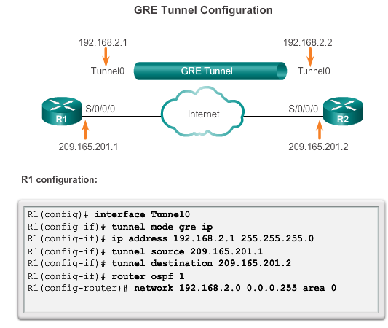
Configuring GRE Tunnels GRE Tunnel Configuration
Notes:
7.2.2.1 GRE Tunnel Configuration

Slide 19
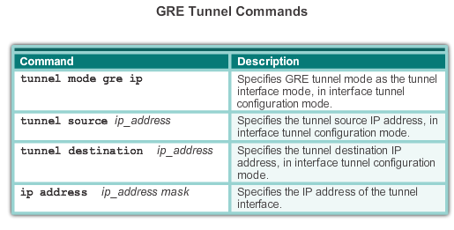
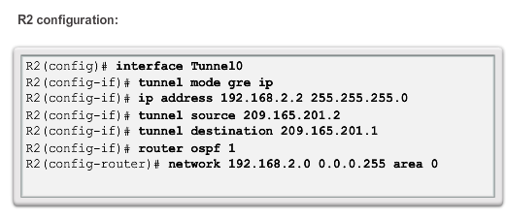
Configuring GRE Tunnels GRE Tunnel Configuration
Notes:
7.2.2.1 GRE Tunnel Configuration

Slide 20
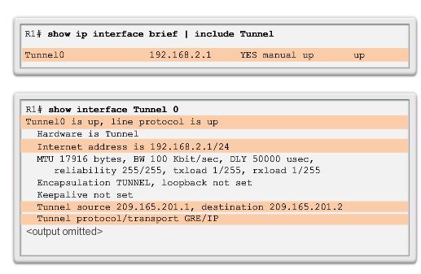
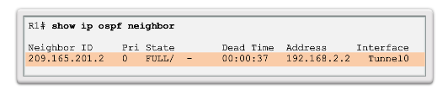
Configuring GRE Tunnels GRE Tunnel Verification
Verify Tunnel
Interface is Up
Verify OSPF Adjacency
Notes:
7.2.2.2 GRE Tunnel Verification

Slide 21
Chapter 7: Summary
VPNs are used to create a secure end-to-end private network connection over a third-party network, such as the Internet.
A site-to-site VPN uses a VPN gateway device at the edge of both sites. The end hosts are unaware of the VPN and have no additional supporting software.
A remote access VPN requires software to be installed on the individual host device that accesses the network from a remote location.
The two types of remote access VPNs are SSL and IPsec.
SSL technology can provide remote access using a client’s web browser and the browser’s native SSL encryption.
Using Cisco AnyConnect software on the client, users can have LAN-like, full network access using SSL.
Notes:
Chapter 7 Summary

Slide 22
Chapter 7: Summary (cont.)
GRE is a basic, non-secure site-to-site VPN tunneling protocol that can encapsulate a wide variety of protocol packet types inside IP tunnels, thus allowing an organization to deliver other protocols through an IP-based WAN.
Today, it is primarily used to deliver IP multicast traffic or IPv6 traffic over an IPv4 unicast-only connection.
Notes:
Chapter 7 Summary

Slide 23


